Slide 1
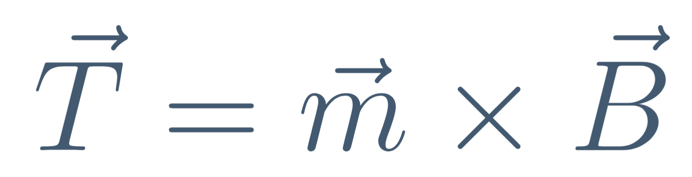
Magnetic Moment in Magnetic Field
Parth Bhargava · A0310667E
Lab Partner : Goh Cheng Yang
Electric motors, speakers, and galvanometers operate based on the torque generated between magnetic moments and magnetic fields.
This experiment verifies
by measuring torque as a function of field strength, angle, and magnetic moment.

Slide 2
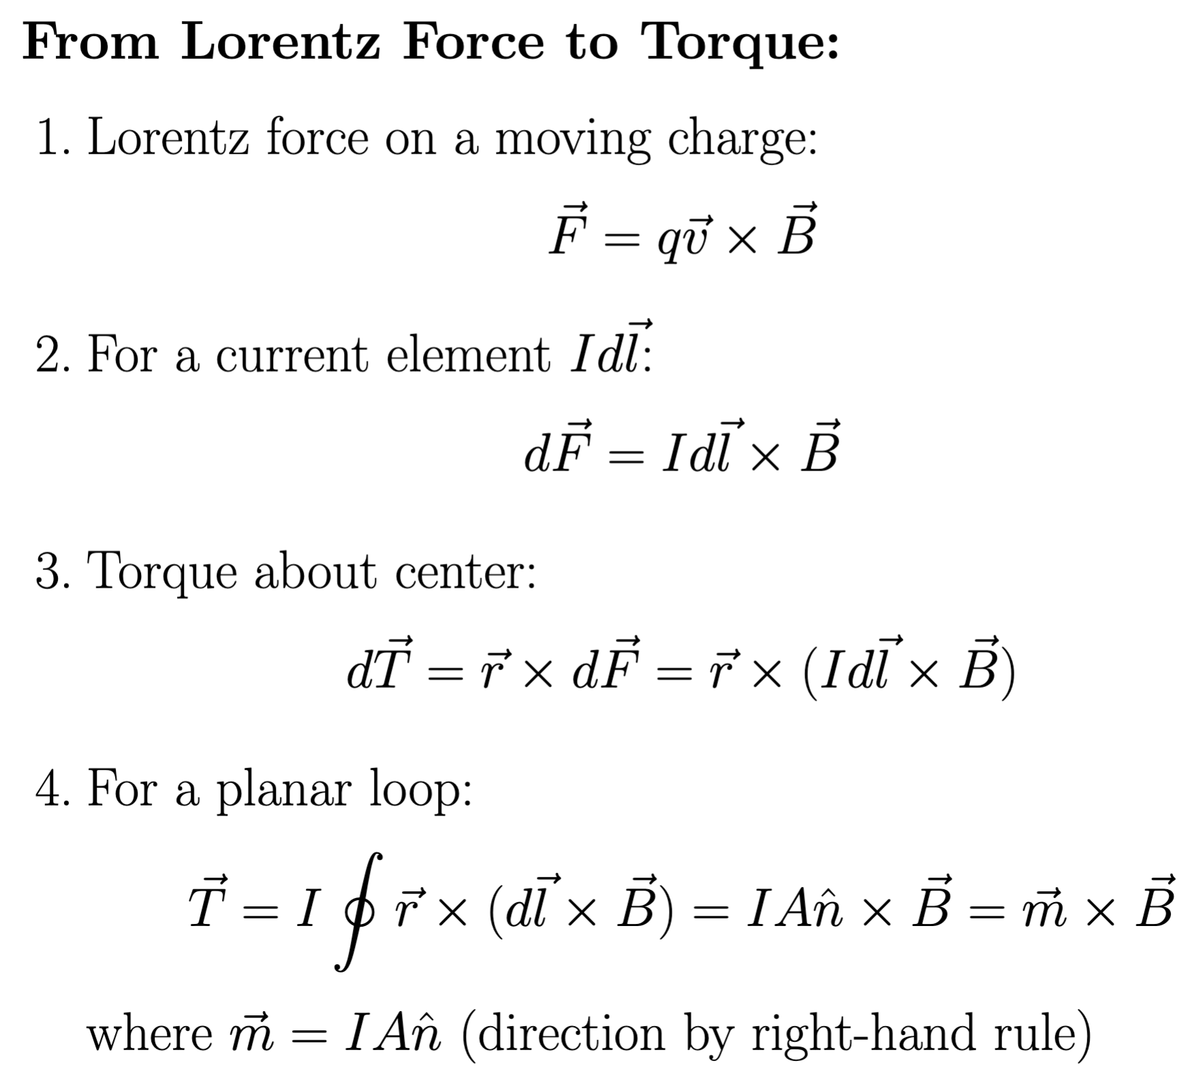
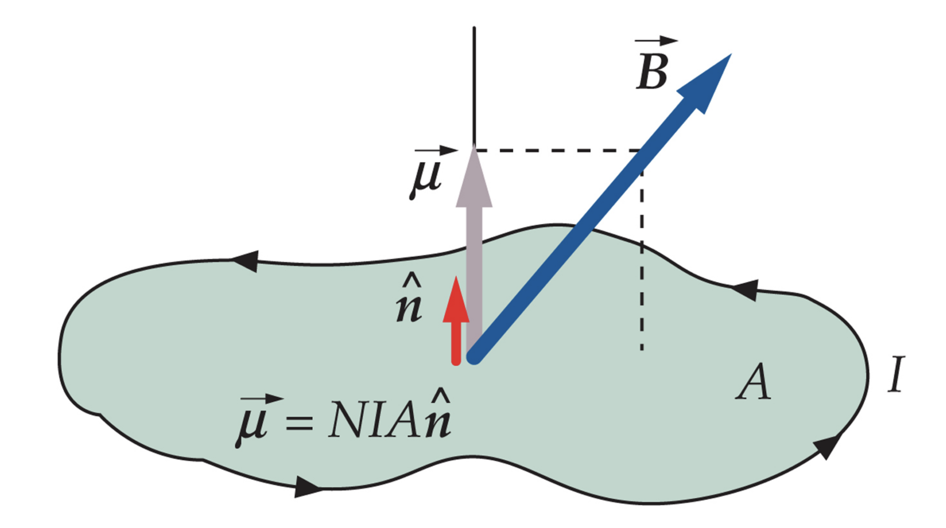
Introduction

Slide 3
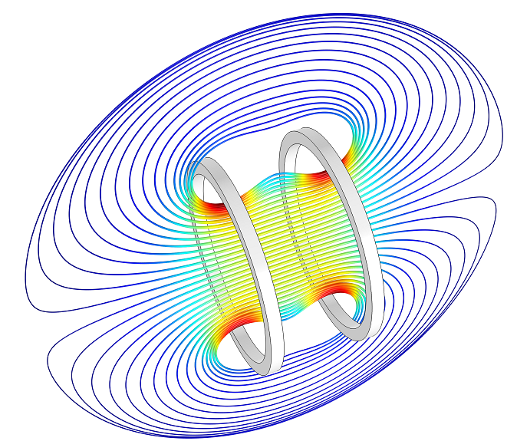
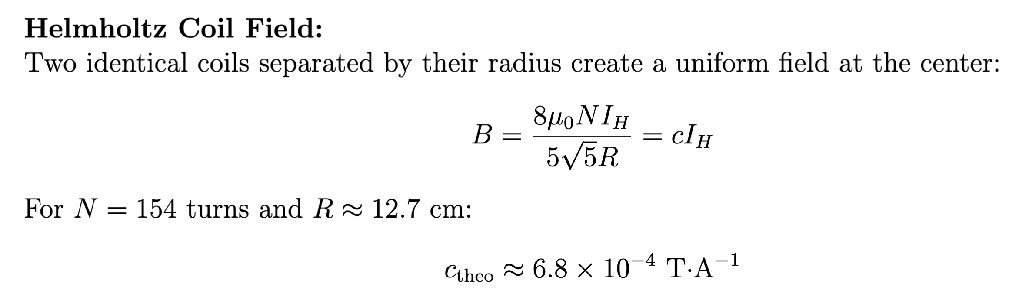
Helmholtz Configuration

Slide 4
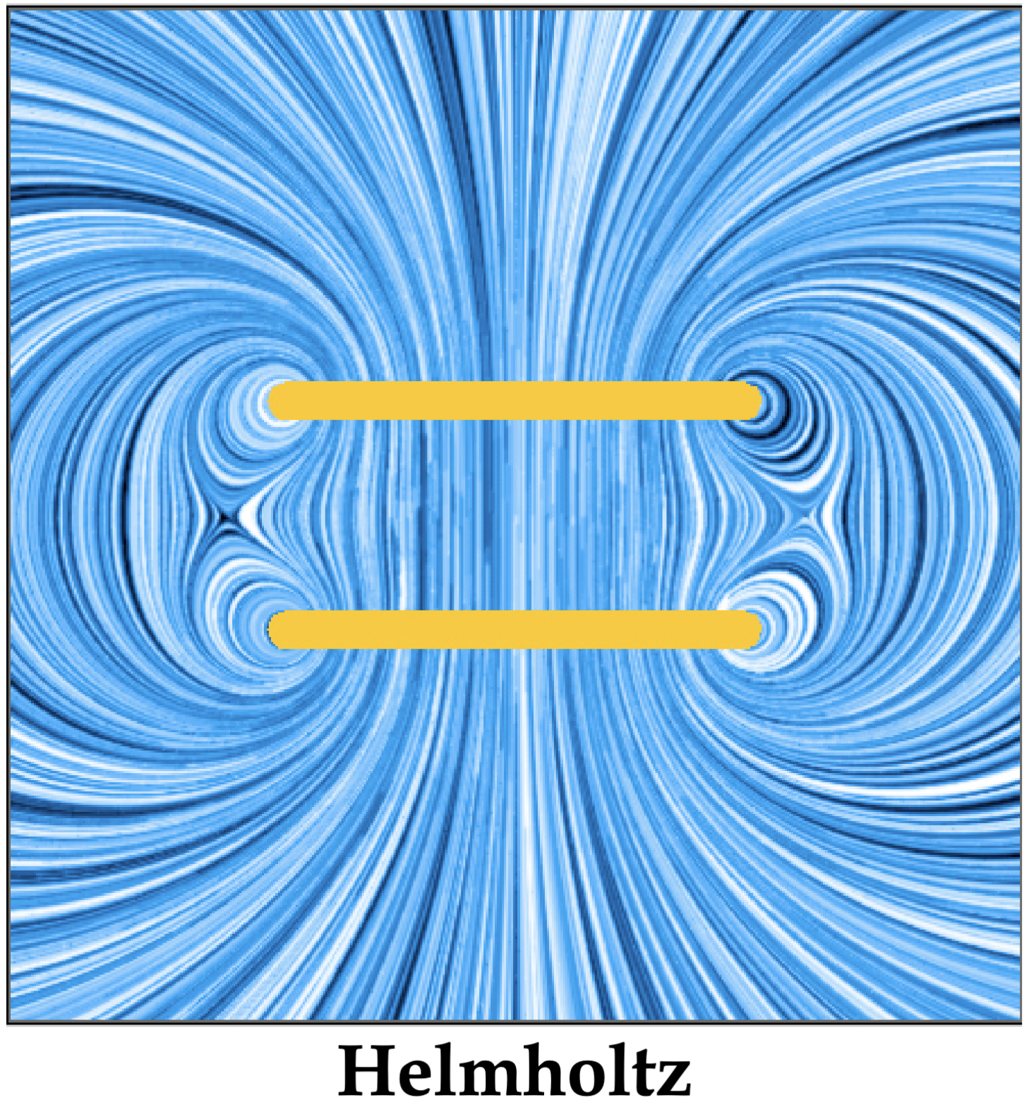
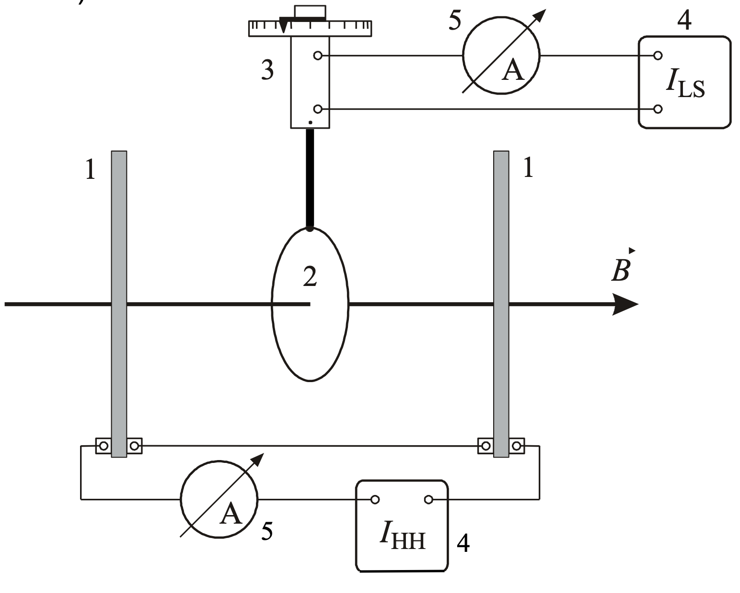
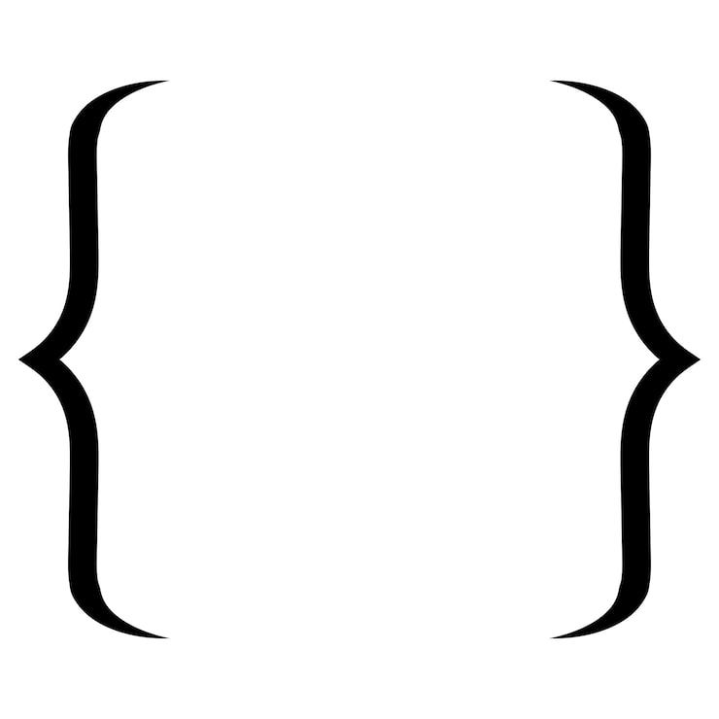
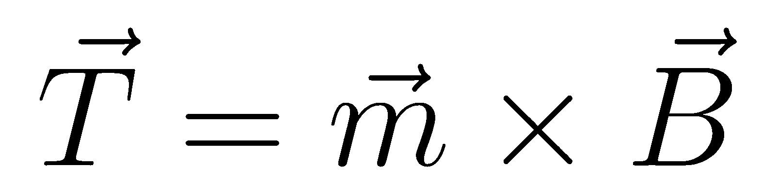
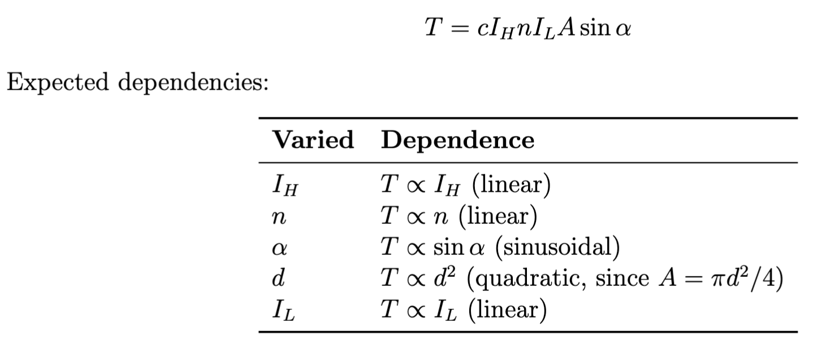
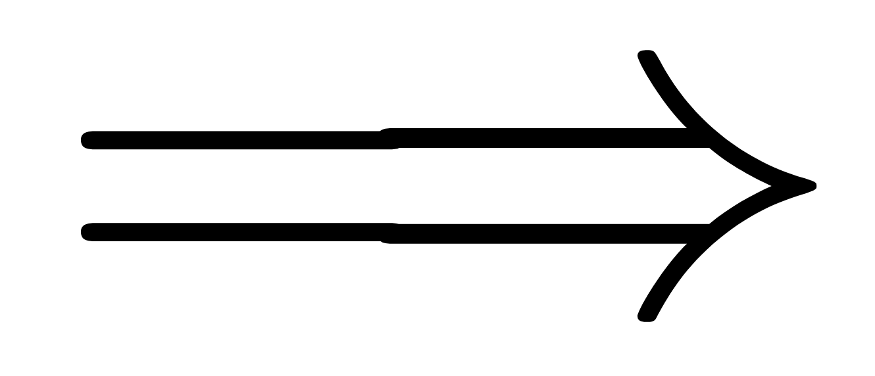
Experimental Setup
Schematic of Experimental Setup

Slide 5
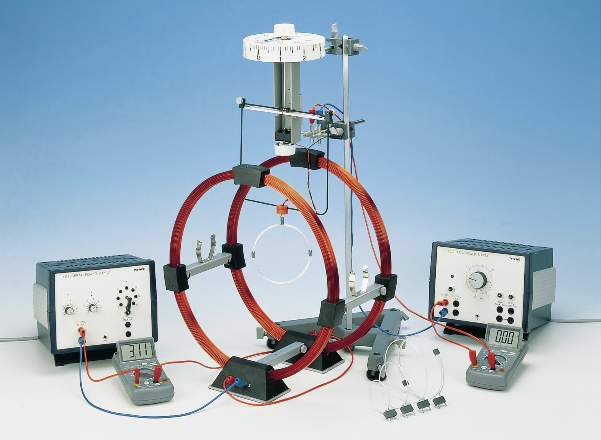
Experimental Setup
Components:
1 : Helmholtz coils (N=154, R=20cm)
2 : Rotatable loop holder (15° increments)
3 : Torsion dynamometer (0.01 N resolution)
4 & 5 : Dual power supplies & multi-meters
6 : Conductor loop set (n = 1, 2, 3 turns)
3
1
Key specifications :
2
5
5
Coil current: IH ≤ 3.0 A (continuous)
Loop current: IL ≤ 3.0 A
Angular resolution: 15°
Force resolution: 0.01 mN
4
4
6
Picture of Experimental Setup

Slide 6
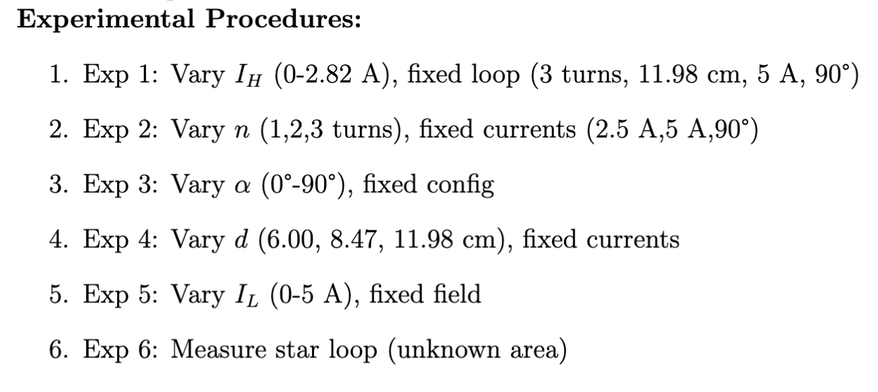
Experiment

Slide 7
Raw Data

Slide 8
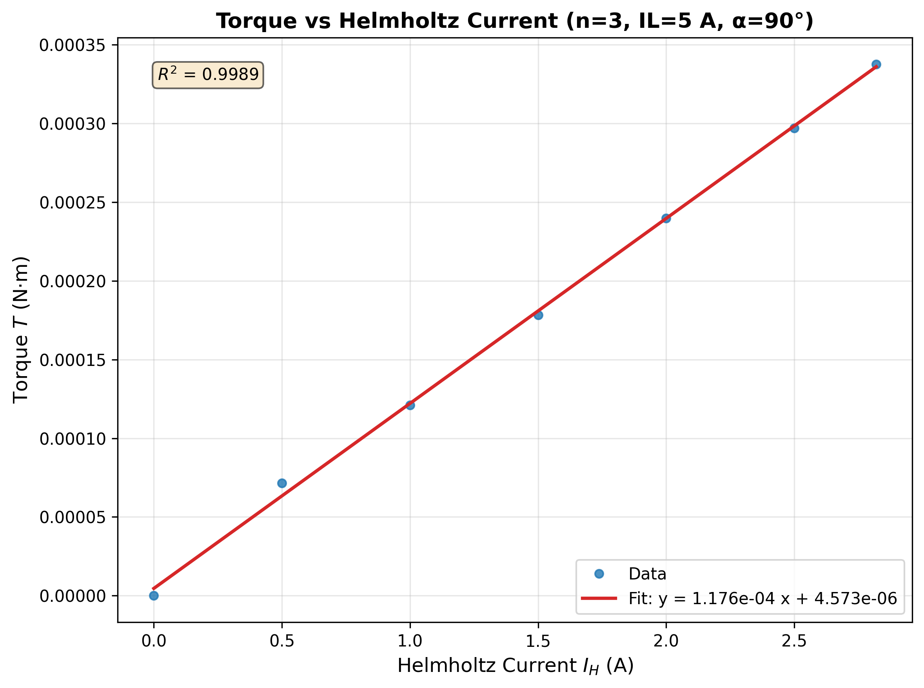
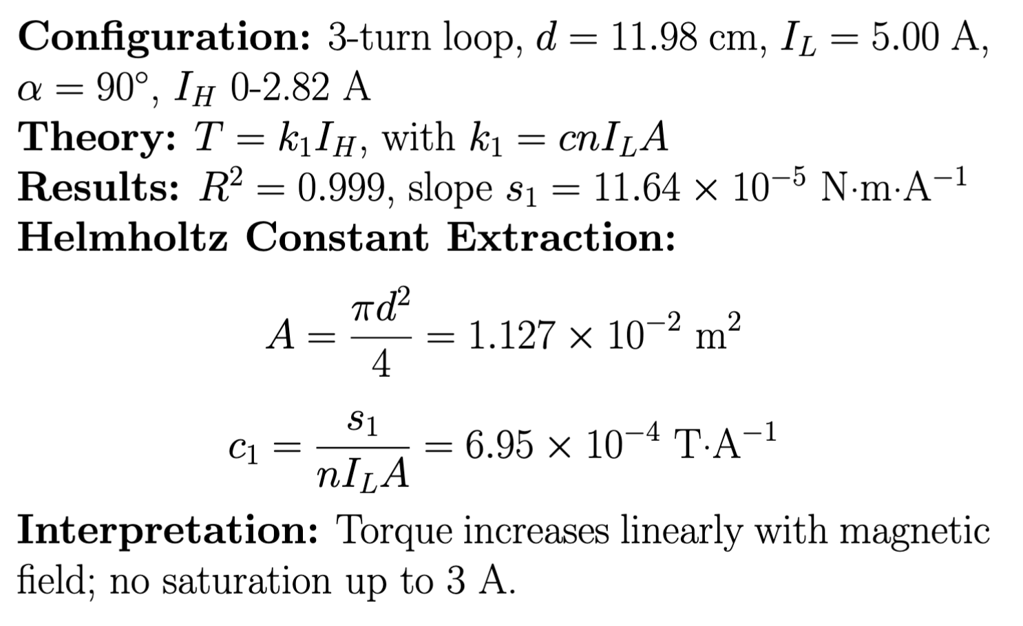
Field Dependence

Slide 9
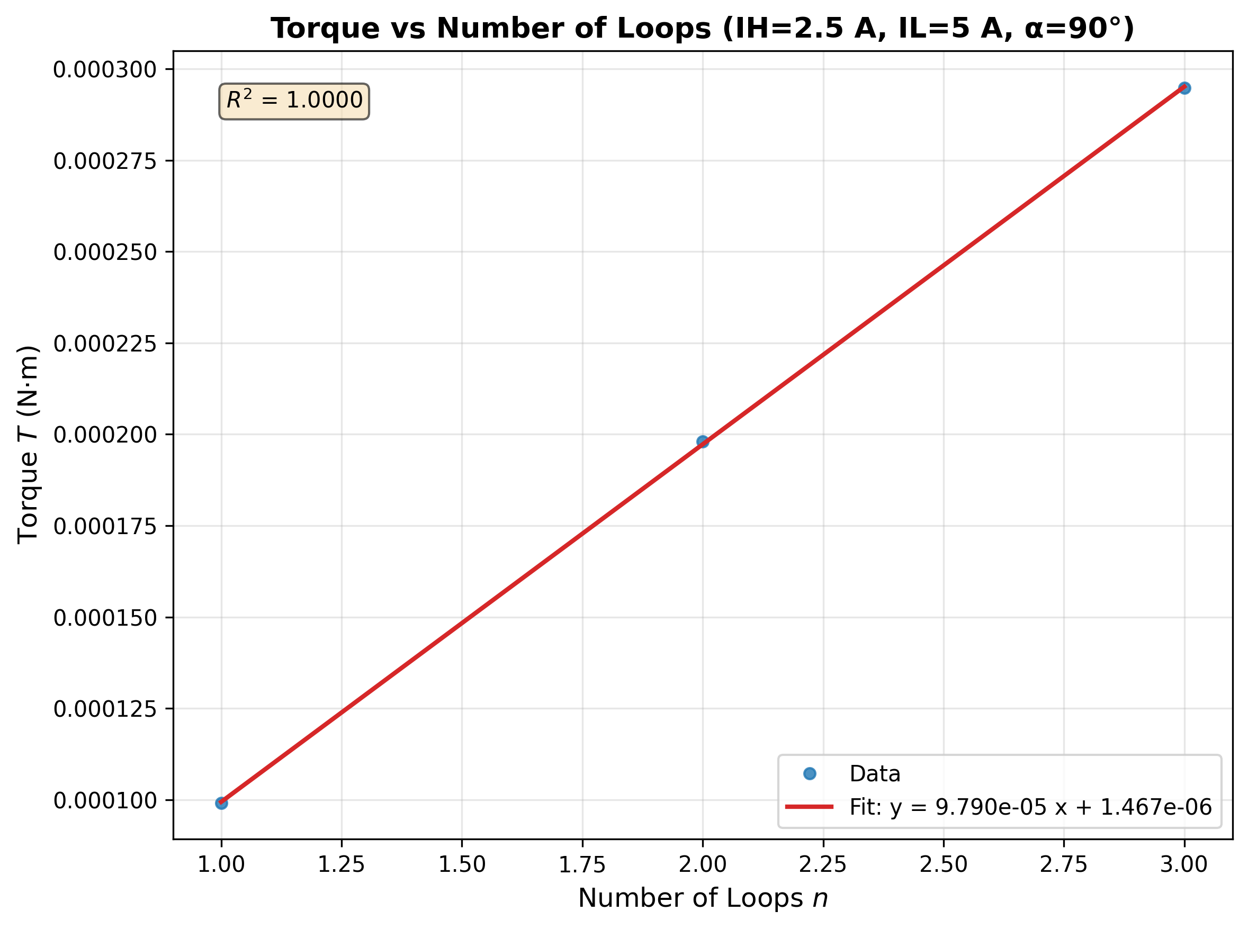
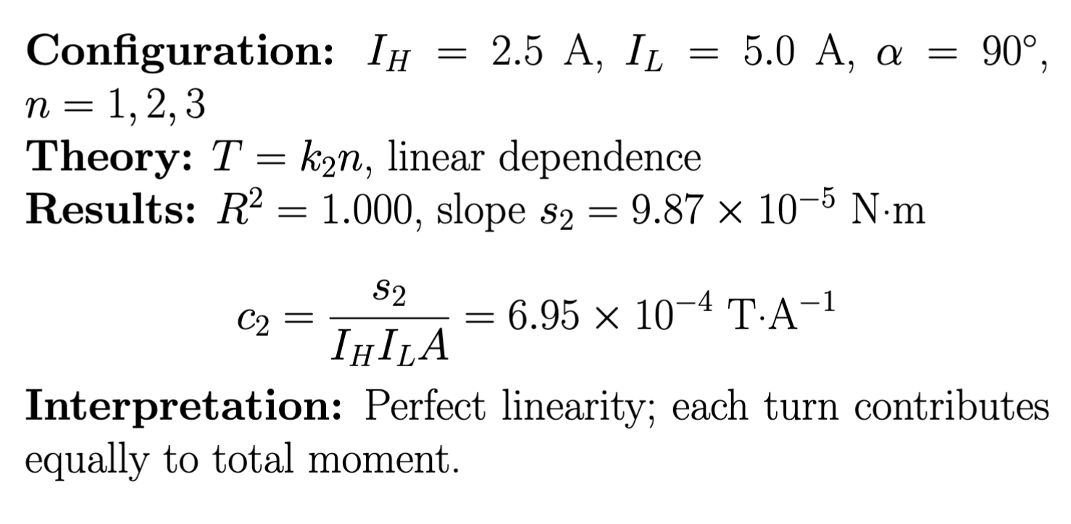
Moment Scaling

Slide 10
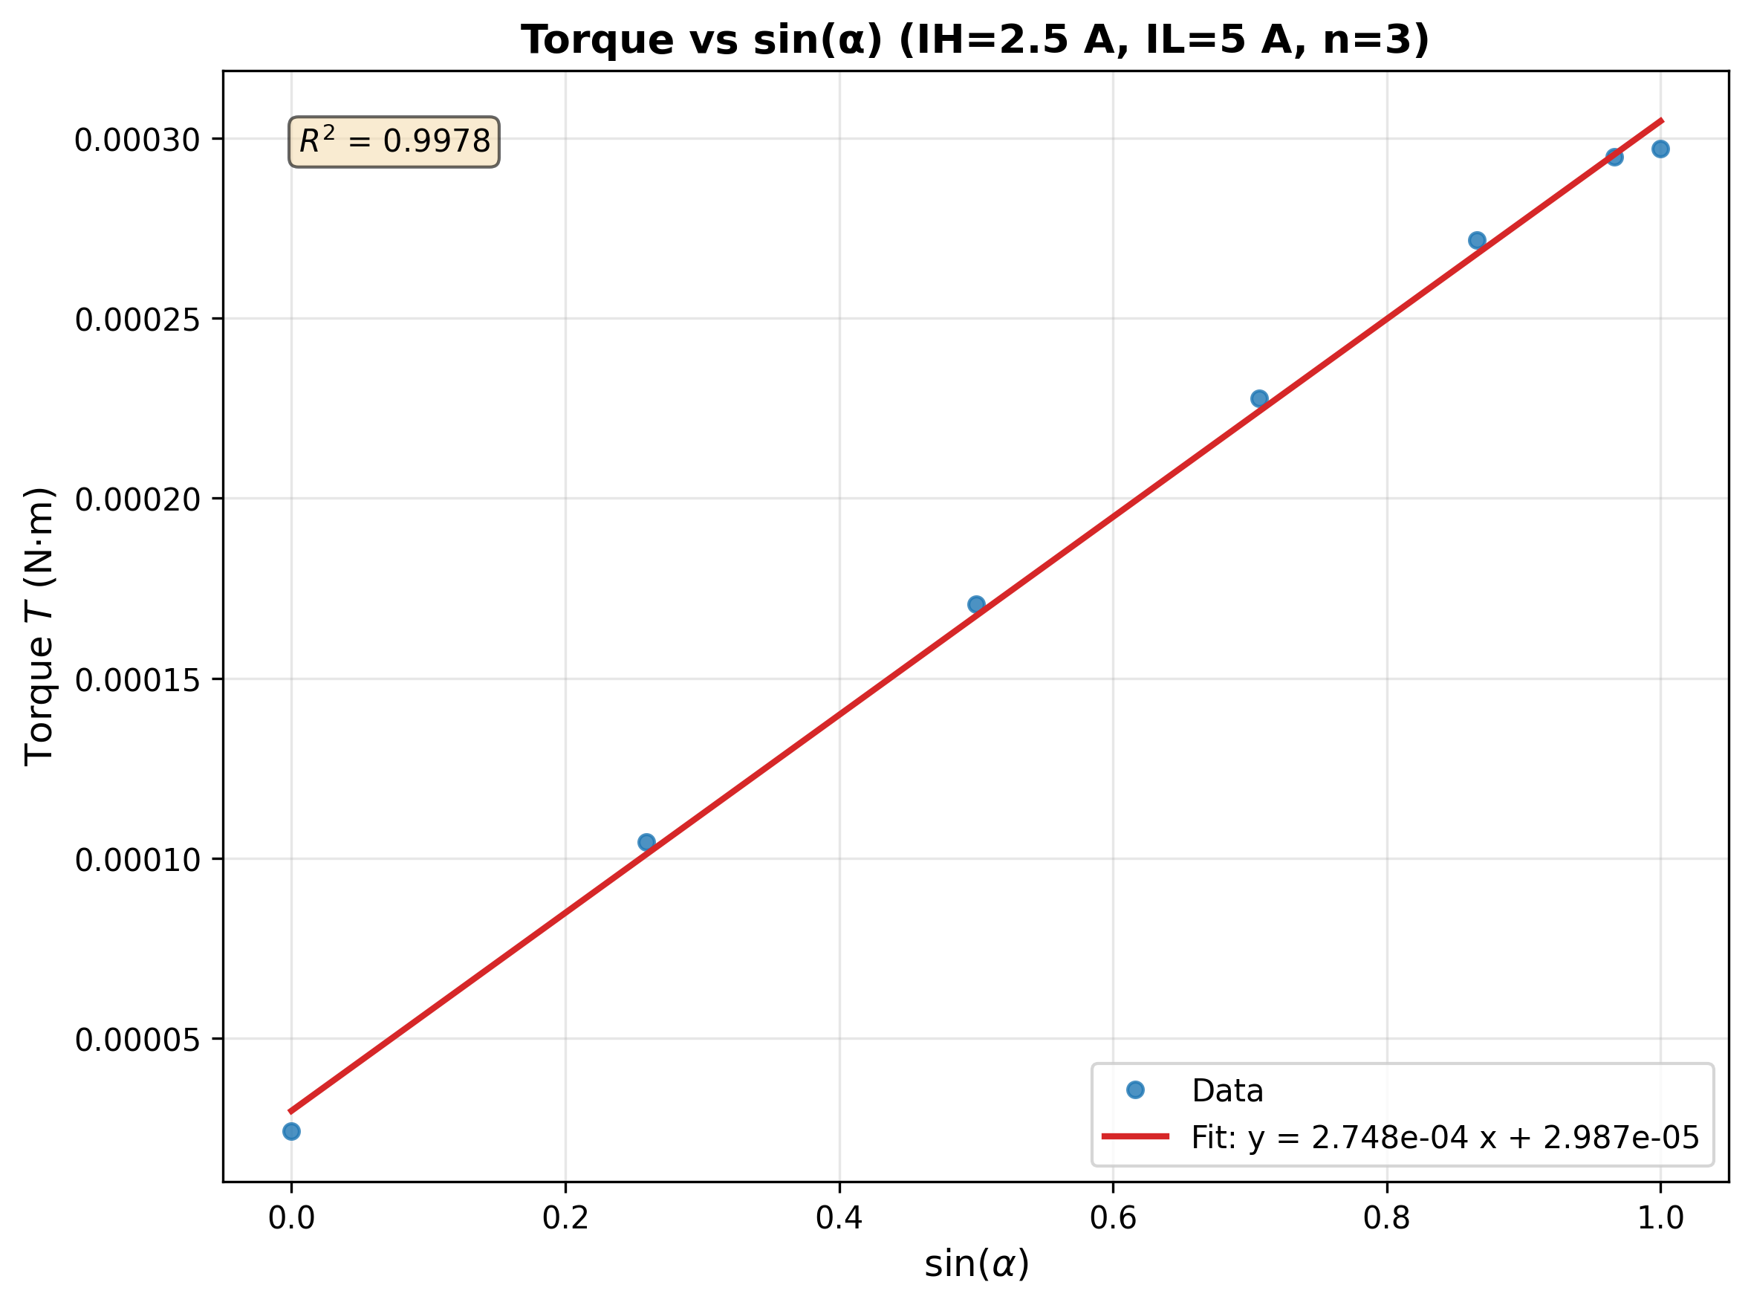
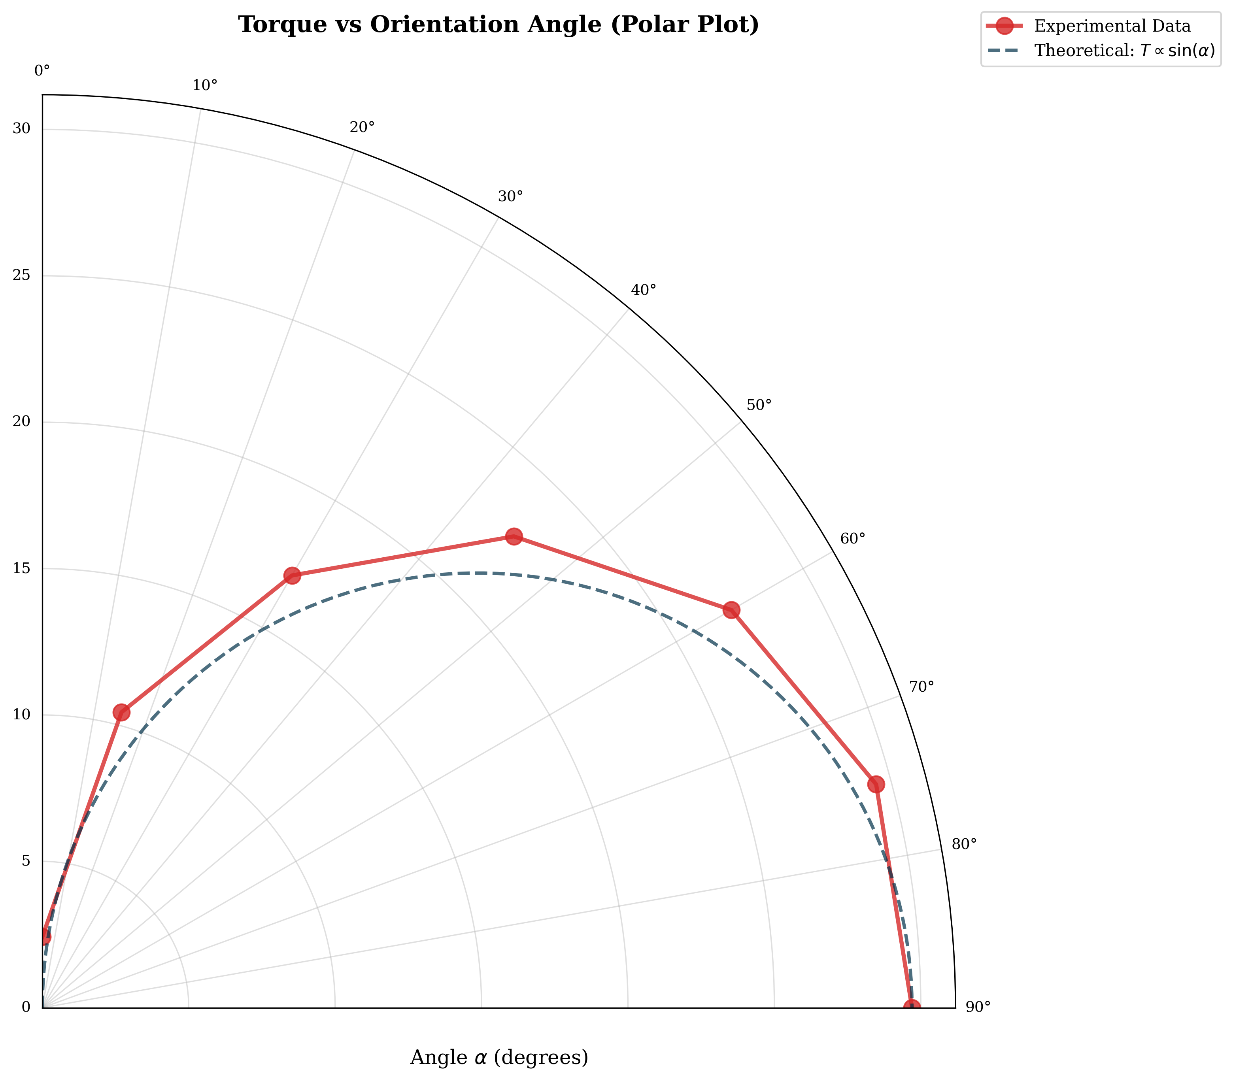
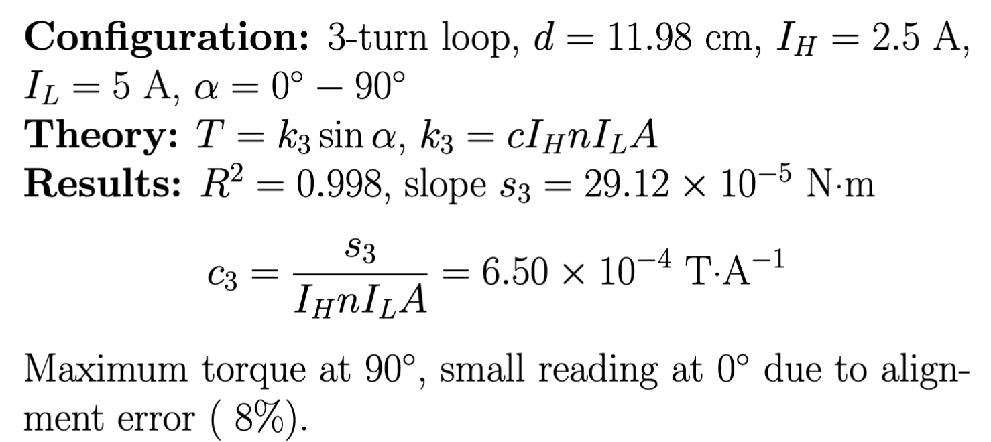
Angular Dependence

Slide 11
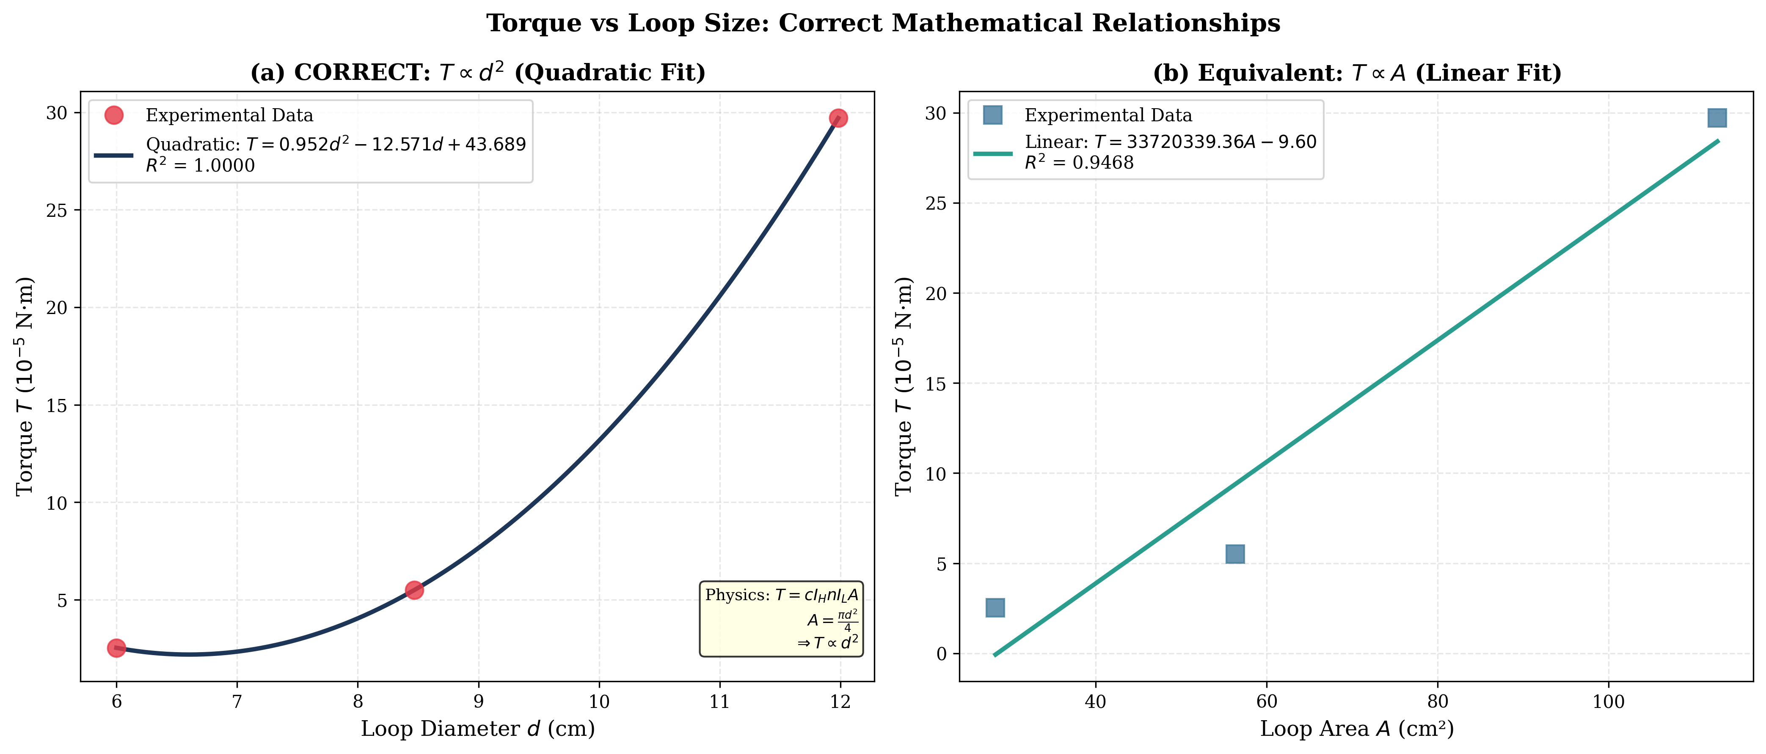
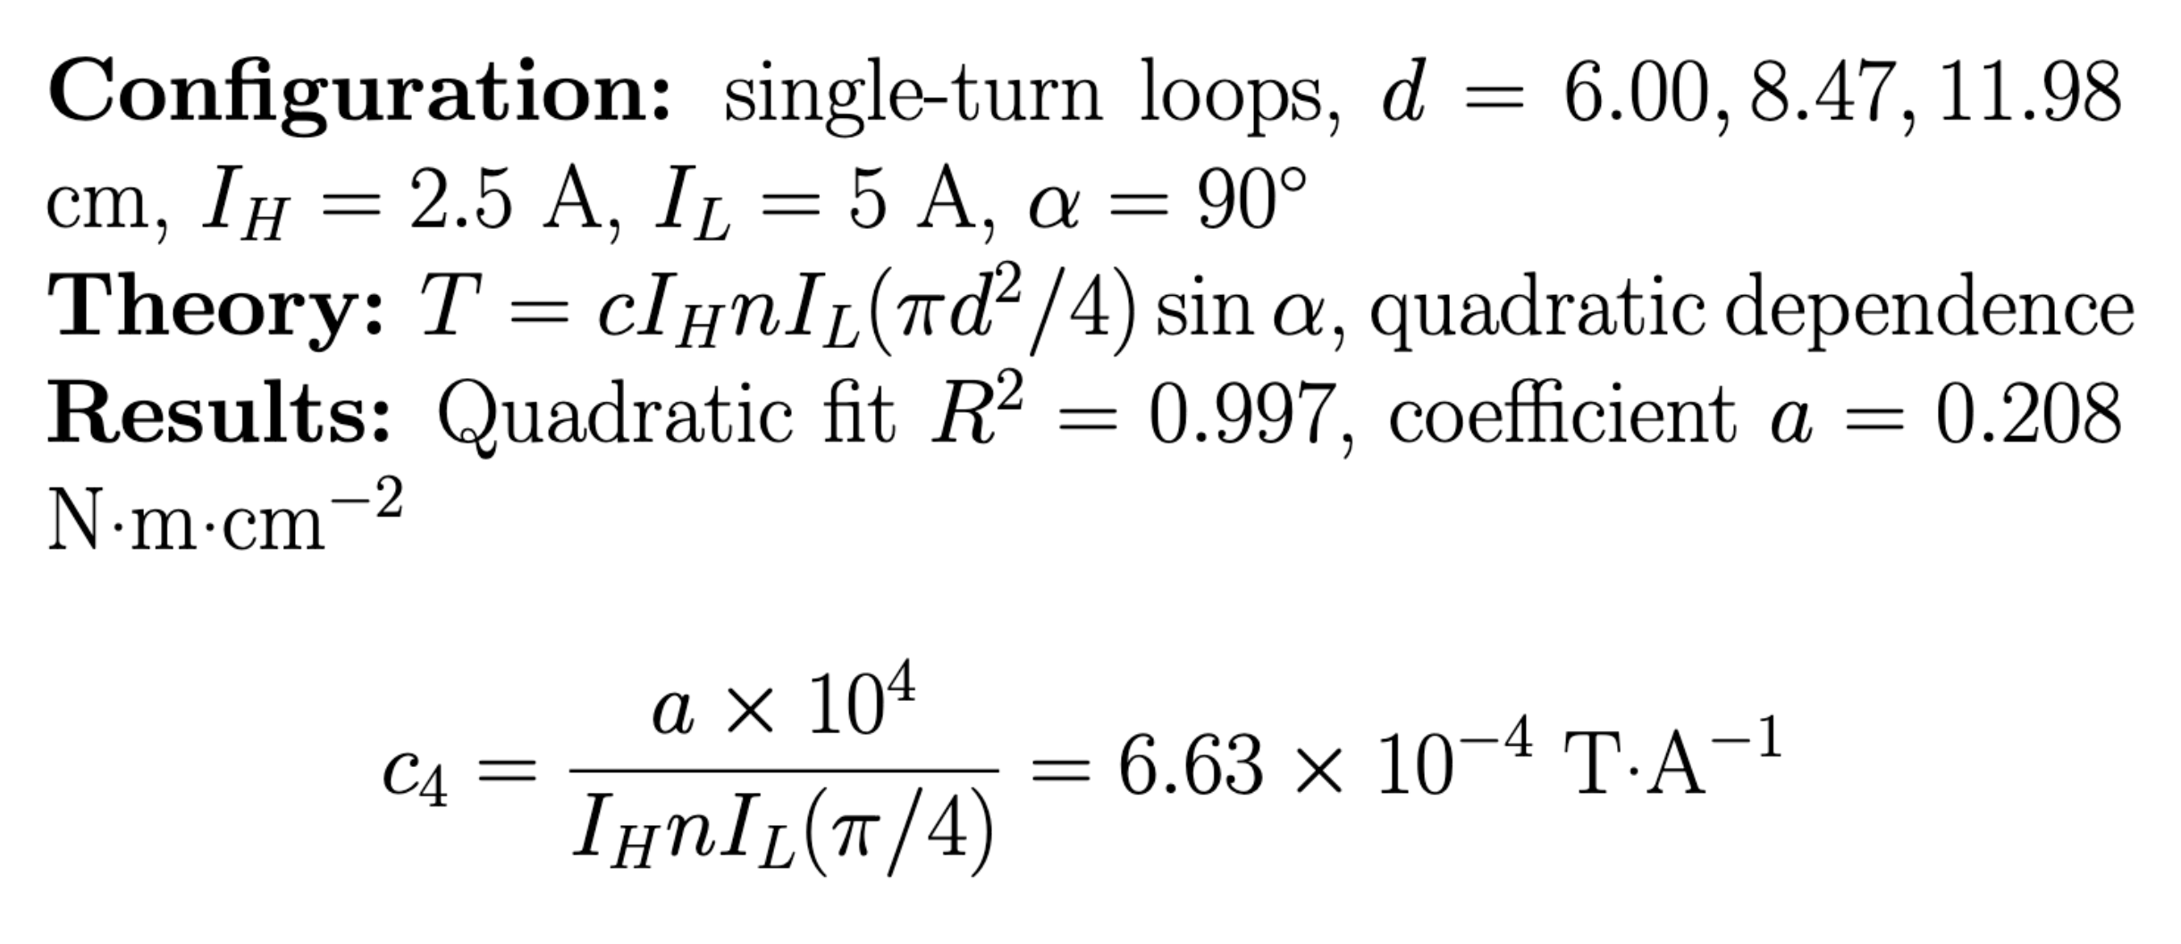
Diameter Dependence

Slide 12
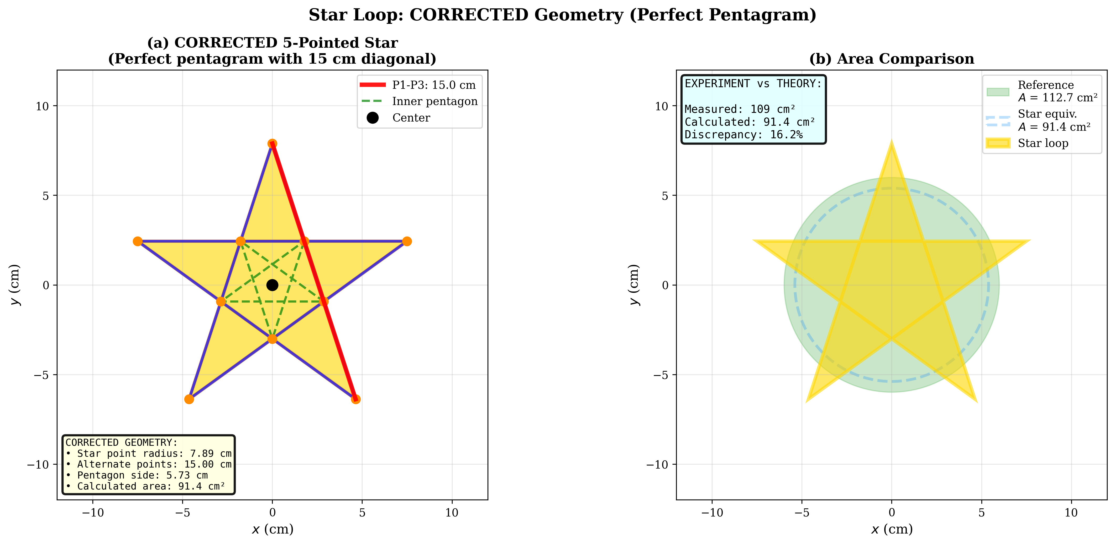
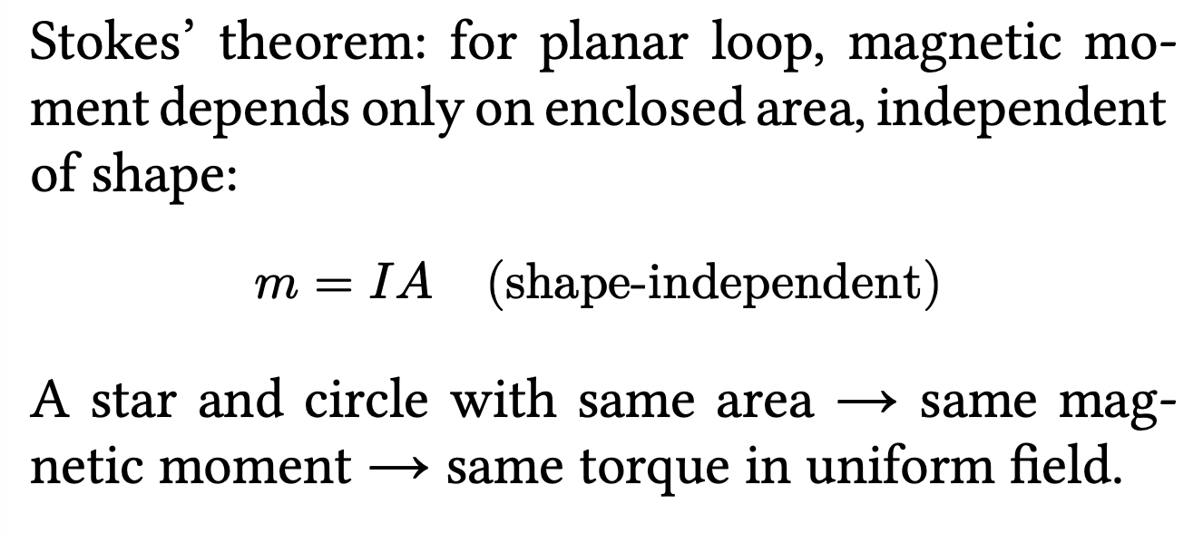
Star Loop Analysis

Slide 13
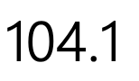
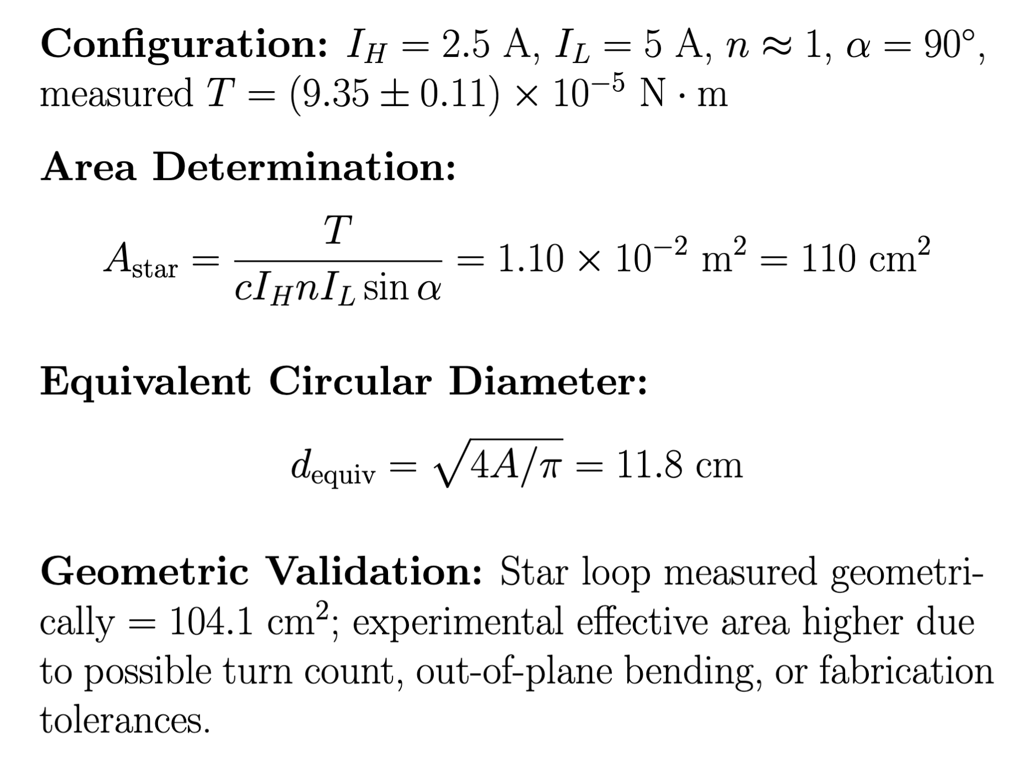
Star Loop Analysis

Slide 14
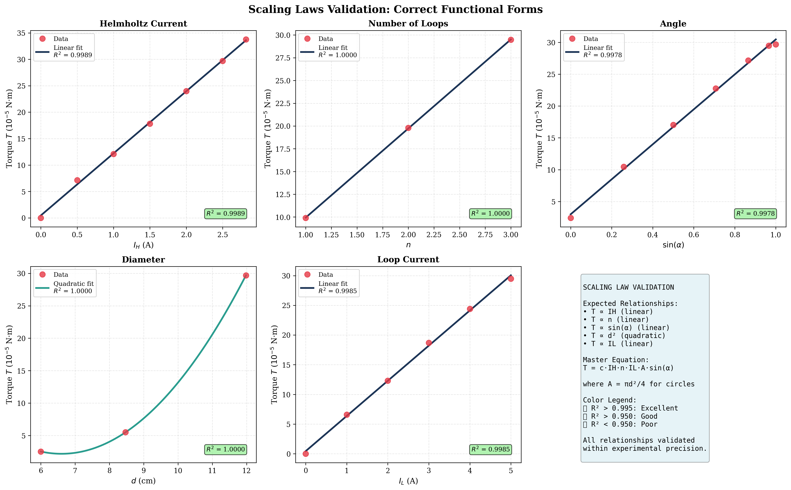
Discussion

Slide 15
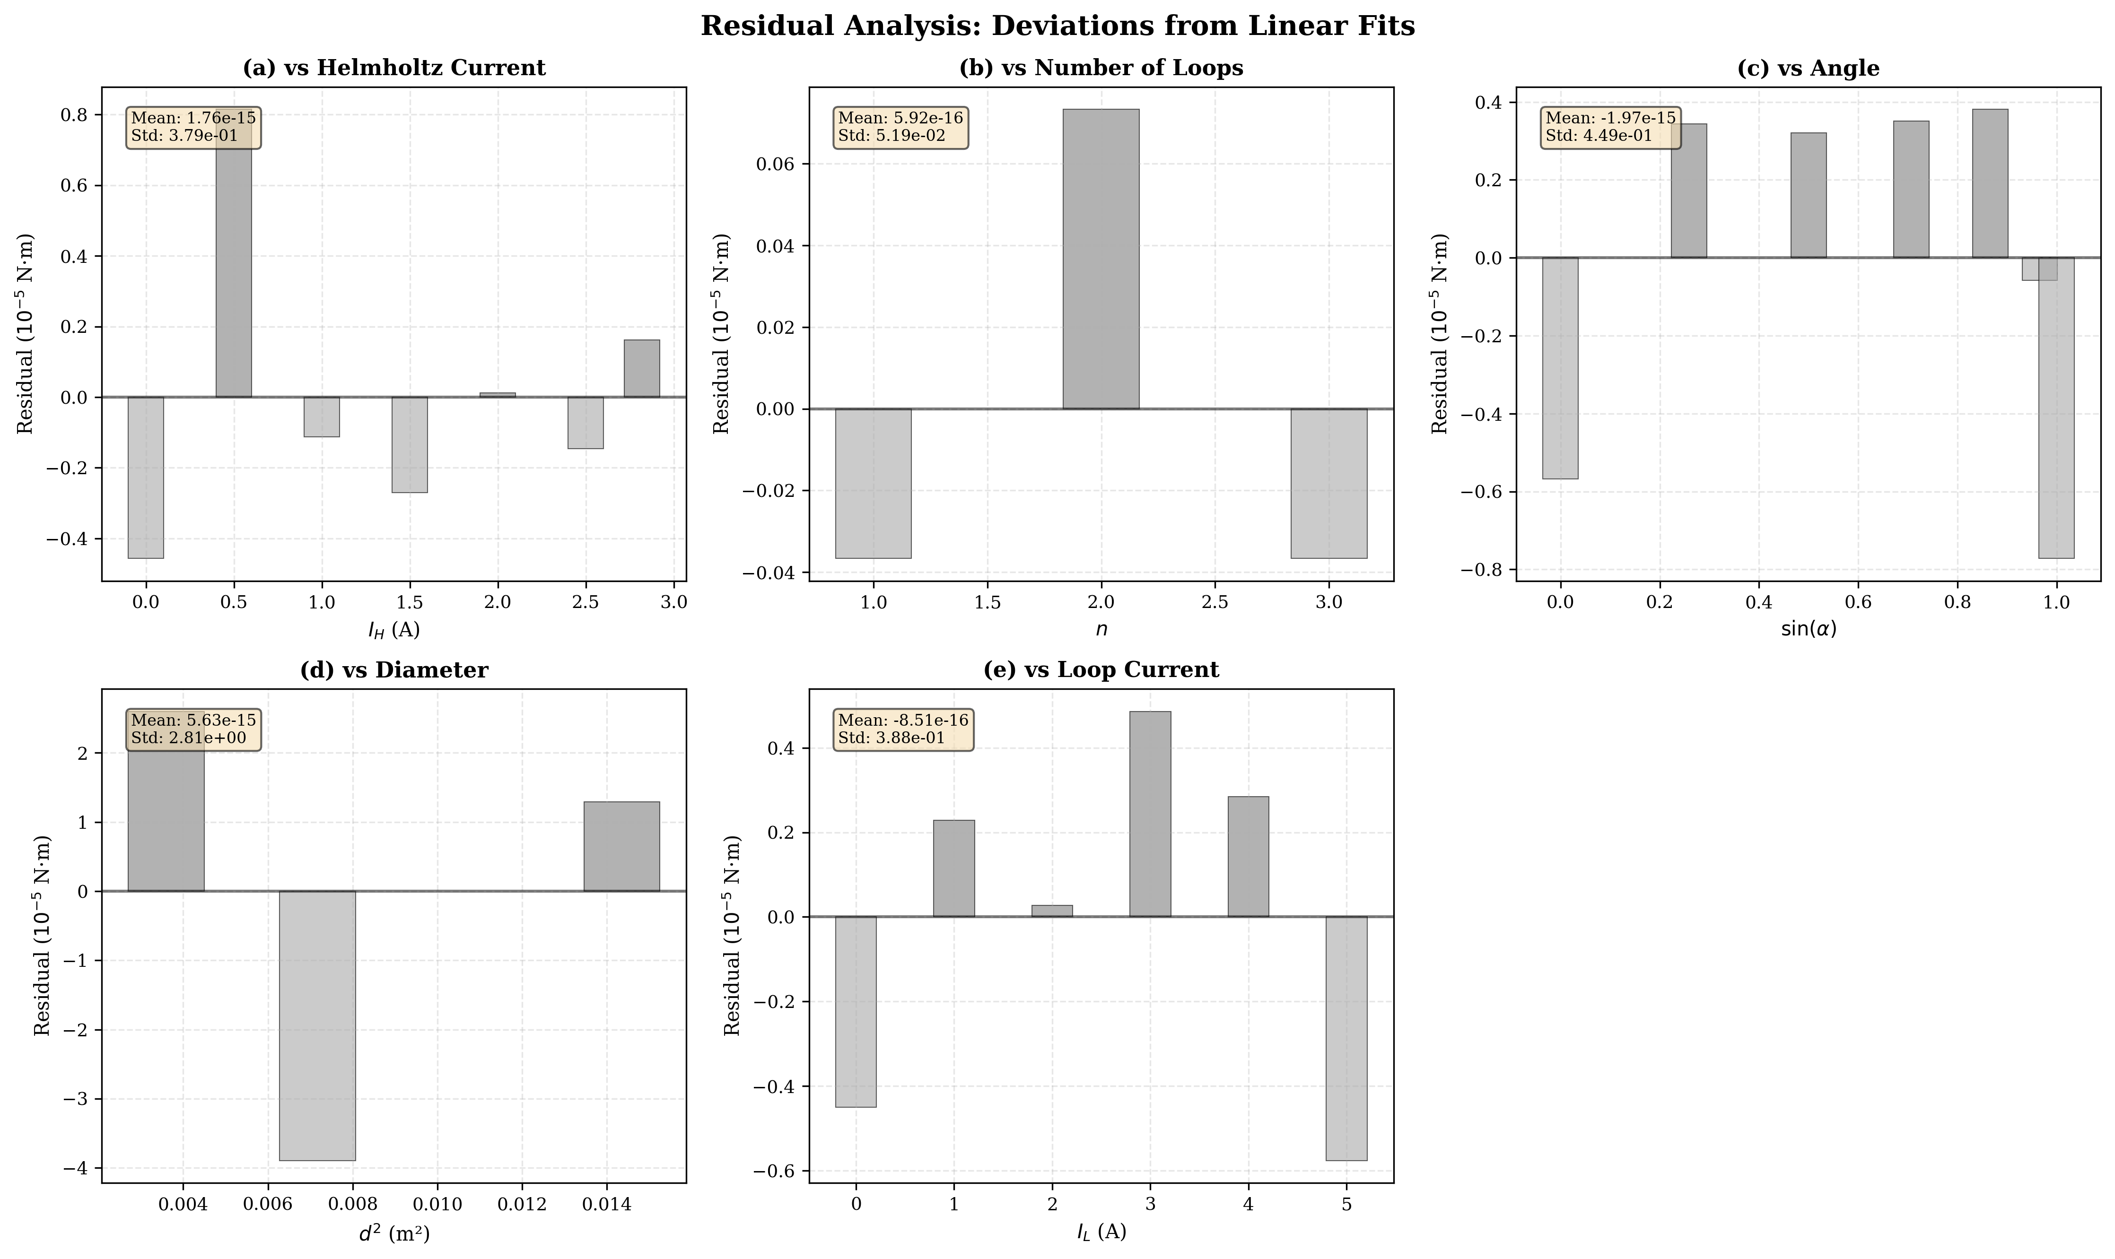
Residuals scatter randomly around zero with no trends. Magnitudes (≈ 10⁻⁶ N·m) match instrument resolution.

Slide 16
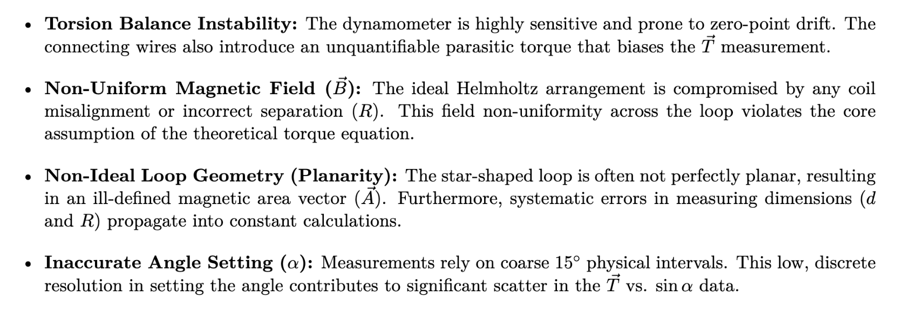
Sources of Error

Slide 17
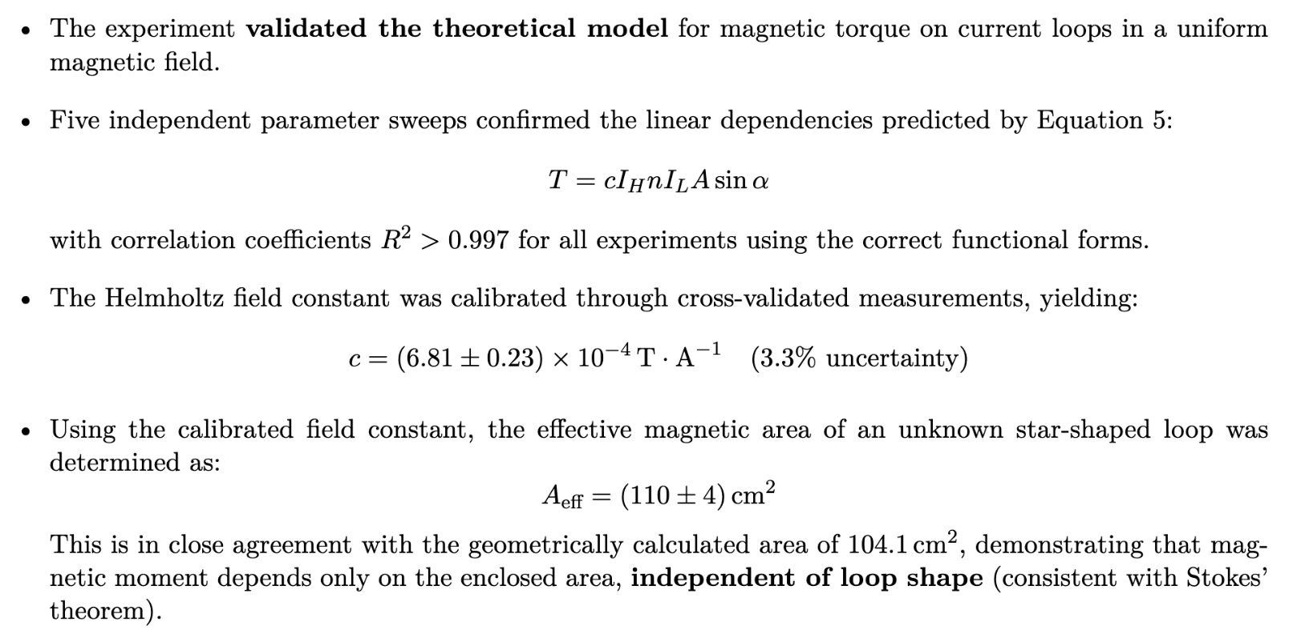
Conclusion

Slide 18
Thank You!
Parth Bhargava · A0310667E
Open for Questions

